Slide 1
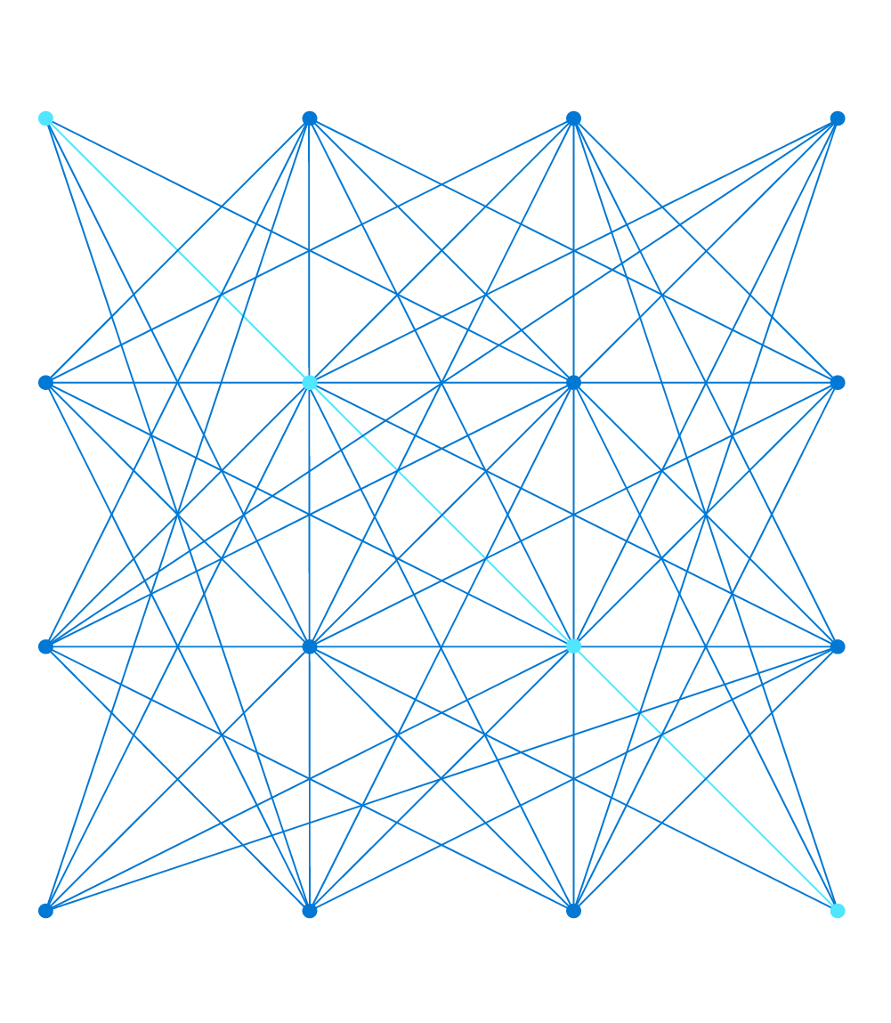

Scaling with Azure
Sarah Lean
Senior Cloud Advocate
@Techielass

Slide 2



Who am I?
Senior Cloud Advocate @ Microsoft
Blog at www.techielass.com
@Techielass
Founder of the Glasgow Azure User Group
STEM Ambassador
14+ years in the IT industry
IT Pro

Slide 3
Introducing the art of the possible
Microsoft Azure | @Techielass

Slide 4
The cloud is changing the way we think about delivering content and applications over the internet.
With private global cloud connectivity from Azure, we can focus on:
simplifying network ownership
optimized end-to-end scenarios
best practice architectures
developer-centric experiences
Microsoft Azure | @Techielass

Slide 5
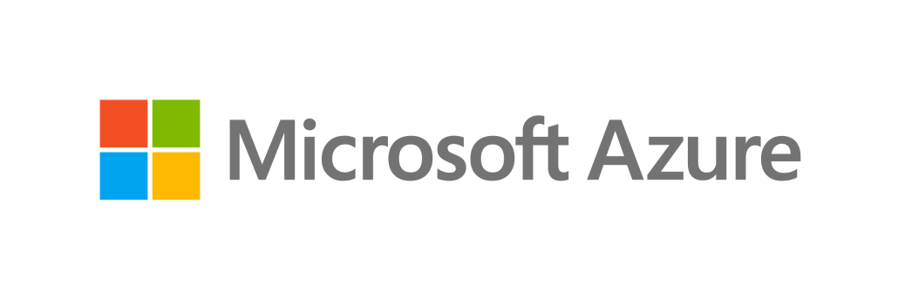
Azure Networking Services
Delivery
Virtual Network
Virtual WAN
ExpressRoute
VPN
DNS
Protect
Connect
DDoS Protection
Firewall
Network Security Groups
Web Application Firewall
Virtual Network Endpoints
Monitor
CDN
Front Door
Traffic Manager
Application Gateway
Load Balancer
Network Watcher
ExpressRoute Monitor
Azure Monitor
Virtual Network TAP
Azure What’s new in Azure Networking BRK2040
Microsoft Azure | @Techielass

Slide 6



What is a Load Balancer?
Distribution of workloads across multiple compute resources
Contoso.com
USED TO:
172.168.37.31
Optimize resource use
Maximize throughput
Minimize response time
Avoid overloading any single resource
Improve availability
Microsoft Azure | @Techielass

Slide 7
Why use Azure for load balancing?
Dynamic scaling
Secure
Integration with Azure services
Cost effective
Rich monitoring and metrics
Microsoft Azure | @Techielass

Slide 8



Azure’s load balancing options
Load Balancer
Application Gateway
Traffic Manager
Front Door
Network Layer (TCP/UDP)
Extreme perf sensitive
Ultra-low latency
Application Layer (HTTP/HTTPS)
TLS/cert based auth
DNS-based load balancing
Variety of routing options
Application Layer(HTTP/HTTPS)
Load balancing at the edge
Microsoft Azure | @Techielass

Slide 9
Azure Load Balancer
Network/Layer 4 load balancer
TCP/UDP applications
Supports HTTP and HTTPS health probes
Ultra-low latency
High bandwidth
Pass-through/ transparent load balancer
No packet transformations
Source IP is maintained
Multiple Public IPs on frontend
Availability zones support
Microsoft Azure | @Techielass

Slide 10
Azure Load Balancer components
Frontend
Public – Public LB
Private – Internal LB
Health probe
Rules
LB rules
Inbound NAT rules
HA port rule
Backend pools
VMs, VMSS
IP addresses
IP
IP
IP
IP
IP
IP
VM
VM
Microsoft Azure | @Techielass

Slide 11
Azure Load Balancer routing
Regional and Global
5 tuple hash
Source IP
Source port
Destination IP
Destination port
Protocol
2 tuple hash
Source IP
Destination IP
IP
IP
IP
IP
IP
IP
VM
VM
Microsoft Azure | @Techielass

Slide 12
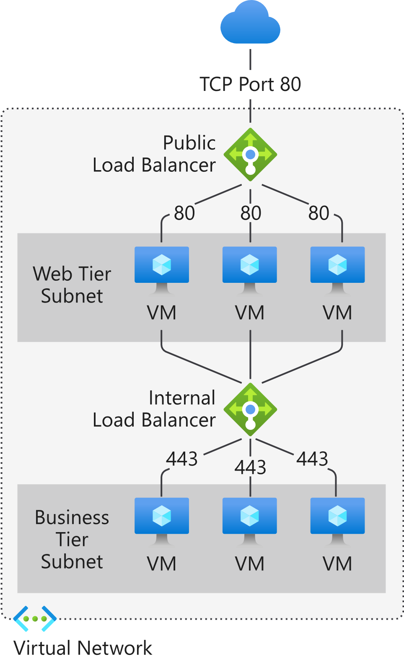
Azure Load Balancer
Microsoft Azure | @Techielass
Microsoft Azure | @Techielass

Slide 13
Application Gateway
Application/ Layer 7 load balancer
HTTP/HTTPS applications
WebSocket and HTTP/2 support
TLS termination
Terminates connections
Source IP is changed
Auto scaling support
Availability zones support
HTTP to HTTPS redirects
Single Public IP on frontend
Microsoft Azure | @Techielass

Slide 14
Application Gateway components
Frontend
Public, Private
Listener
Routing rules
Backend pools
VMs, VMSS
IP addresses, FQDN
Microsoft Azure | @Techielass

Slide 15

Application Gateway routing
Contoso.com
172.168.37.31
Regional
Content based
Incoming URL attributes
/images/*
/video/*
Host/domain name based
Cookie based session affinity
Microsoft Azure | @Techielass

Slide 16


Azure Application Gateway
Static VIP
Autoscaling
Grows and shrinks based on application traffic requirements
No need to overprovision or guess instance size
Reduce operating cost
High performance SSL offloads
500-50,000 connections/sec with RSA 2048 bit key Certs
30,000-3,000,000 persistent connections
2500-250,000 HTTP req/sec
Min capacity
Scale out at load
Avail Zone 1
Avail Zone 2
VMSS
VMSS
Autoscaling, improved performance and
faster provisioning
Microsoft Azure | @Techielass

Slide 17










Azure Web Application Firewall Cloud native Web Application Firewall
OWASP rules
Bot management
WAF policy
Custom rules
Unified WAF offering
Protect your apps at network edge or in region uniformly
Microsoft threat intelligence
Protect apps against automated attacks
Manage good/bad bots with Azure BotManager RuleSet
Site and URI path specific WAF policies
Customize WAF policies at regional WAF for finer grained protection at each host/listener or URI path level
Geo filtering on regional WAF
Enhanced custom rule matching criterion includes filtering by country
Uniform policy
Azure Global WAF (Front Door)
Azure Regional WAF (Application Gateway)
PaaS, IaaS and on-premise backends
Microsoft Azure | @Techielass

Slide 18
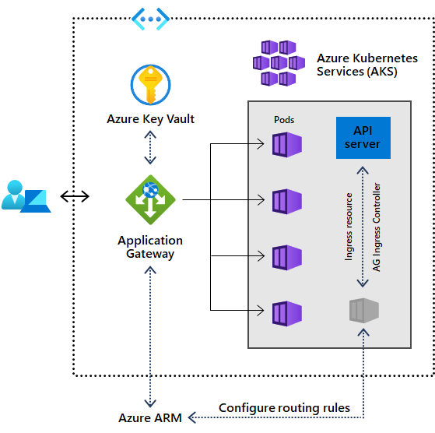
Ingress Controller with AKS
Application Gateway Ingress Controller
Performance benefits over in-cluster ingress controllers
AKS add-on allows for one line deployment of:
Cluster
Add-on
Application Gateway
Add-on is a fully managed way to integrate native L7 load balancing with AKS
Microsoft Azure | @Techielass

Slide 19
Traffic Manager
DNS-based load balancer
Supports external, non-Azure endpoints
Hybrid cloud and on-premises deployments
Public facing endpoint
Routing methods
Priority, weighted, performance, geography, subnet, multi-value
Microsoft Azure | @Techielass

Slide 20
Scenarios
www.contoso.com
CNAME
contoso.trafficmanager.net
Load-balancing and
Endpoint monitoring
Cloud service
Azure web site
Non-Azure
Endpoints
Microsoft Azure | @Techielass

Slide 21




How Traffic Manager Works
User requests ‘www.contoso.com’; client starts with DNS request
Recursive DNS service resolves www.contoso.com to contoso.trafficmanager.net
Recursive DNS service queries Traffic Manager name server
Traffic Manager chooses which endpoint to return, based on traffic-routing method and health checks
Endpoint is returned in DNS
Recursive DNS service completes the DNS chain to obtain IP address
DNS results returned to client
Client connects directly to endpoint IP address, not through Traffic Manager
www.contoso.com IN CNAME contoso.trafficmanager.net
contoso-eu.cloudapp.net A <EU IP Address>
Recursive DNS server
8
Client connects directly to endpoint, not through Traffic Manager
Select endpoint
Microsoft Azure | @Techielass

Slide 22
Weighted Traffic Routing
Enables tailored load distribution across deployments
Configure ‘weight’ on each endpoint
Traffic directed at random to an available endpoint based on weights
Includes health checks + failover
Scenarios
Maximize utilization
A/B testing
Smooth migrations
*’Weighted’ traffic routing is called ‘Round Robin’ in the ASM APIs and ‘classic’ portal
Traffic Manager
1%
49%
50%
West US
West US
East US
Microsoft Azure | @Techielass

Slide 23
Performance Traffic Routing
Enables faster application performance
Traffic directed the endpoint ‘closest’ to the user
Based on DNS query source IP + network latency table
Includes health checks + failover
Scenarios
Improved performance with resilience to regional failure
Microsoft Azure | @Techielass

Slide 24

Geo Routing
Directs users from specific geo locations to specific endpoints
Customer chooses the geo regions to endpoint mapping
Based on DNS query source IP + geo->IP table
Regions can be specified at a global, continent (e.g. South America), country (e.g. Indonesia) or state / province (e.g. Canada-Ontario) level.
State / province granularity supported only for Australia, Canada, UK and USA.
Includes health checks + failover
Scenarios
Compliance with data sovereignty mandates
Microsoft Azure | @Techielass

Slide 25

External Endpoints
Traffic Manager supports endpoints outside of Azure
Simply specify an arbitrary DNS name, e.g. mysite.contoso.com
Works with all traffic-routing methods
Enables a variety of ‘hybrid’ scenarios
Smooth migration from on-premises to Cloud
Geo-expansion of existing applications
Burst-to-Cloud
Failover-to-Cloud
Traffic Manager
Azure Endpoint
On-Premises Endpoint
Microsoft Azure | @Techielass

Slide 26
Nested Profiles
Enable richer profiles with greater flexibility for large/complex deployments
Example
Level 1: Route to user’s nearest Geo (US, EU, ASIA)
Health check information propagates upwards
No cost or performance penalty
Level 2: Route to nearest Region, with cross-region failover within the Geo
Level 3: Load-balance within the region, divert 1% to test system
US West
US East
Europe North
Europe West
Application Endpoints
Microsoft Azure | @Techielass

Slide 27

Real User Performance
Use the data
Latency characteristics of your end users
Increased accuracy for routing decisions
Microsoft Azure | @Techielass

Slide 28
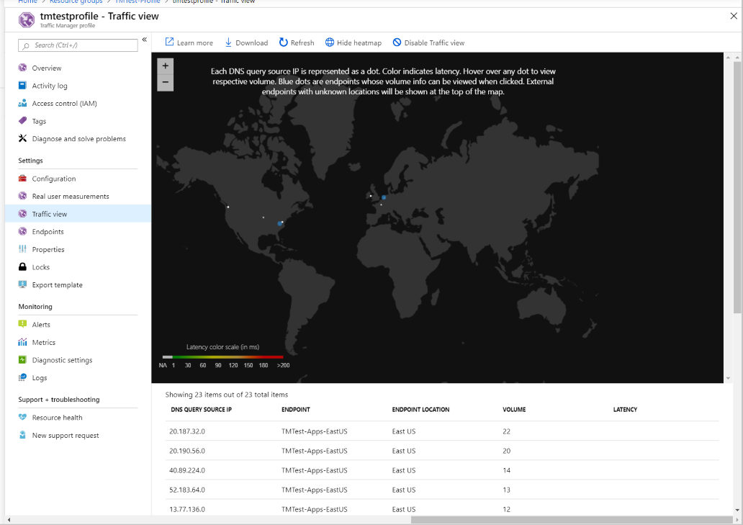
Traffic View
Use the data
Understand more about your users
Understand your user’s experience
Make informed decisions
Microsoft Azure | @Techielass

Slide 29
DEMO
Microsoft Azure | @Techielass

Slide 30


Azure Front Door Service
Region 1
Global secure entry-point to the cloud
Application acceleration at Microsoft’s edge
Global HTTP load balancing with fast failover
Massive SSL offload, integrated static caching
Global WAF at edge, secure, protect services
Free domain and certificate management
Global app dashboard, service insights
Edge Location
Region 2
/*
/search/*
/statics/*
www.contoso.com
Region 3
Global HA, BCDR
Security at the Edge
Faster apps
Enable fast-failover for regional services, microservices at the Edge with active path monitoring
Stop threats where they come from at the Edge with DDoS protection and customizable WAF
Reduce latency and increase throughput for apps by offloading SSL at the Edge and accelerating requests
Microsoft Global Network
Microsoft Azure | @Techielass

Slide 31
Azure Front Door
Global, edge load balancer
Layer 7 (HTTP/HTTPS)
Anycast protocol
Split TCP
Internet facing
Advanced routing
Priority, weight
Microsoft Azure | @Techielass

Slide 32








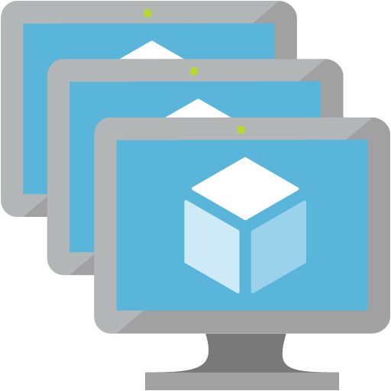






Built-in failover
Health probes determine fastest
available backend
Anycast picks the closest POP
BGP does auto-failover to next available POP
Each POP with its own profile of backend health
Clients/Users
Fast failover if backend fails health probe or latency degrades
App Backends
AFD POPs
Microsoft Azure | @Techielass

Slide 33


On Prem to Cloud Migration with Front Door
On Prem / Legacy DC
Change your app without your users knowing
Stable connections and IP addr. across origins
Route to closest origin in any cloud, on prem
Try new services and quickly fail away if needed
Split off modern microservices to cloud, PaaS
Operate/migrate services across cloud providers
Internet
Edge Location
Edge Location
Azure Region
/*
/search/*
/statics/*
www.contoso.com
Edge Location
Microsoft Global Network
Internet
Stable entry point
Fast global routing
Fast fail-out
Give users a stable IP, connections and best experience while backends migrate, change, modernize, experiment.
Route to backend in Azure or internet endpoints by using Microsoft’s global WAN
Quickly detect app failures or fail-out of a new app deployment, new region, new microservice breakout.
Other Cloud Service
Microsoft Azure | @Techielass
Microsoft Azure | @Techielass

Slide 34
DEMO
Microsoft Azure | @Techielass

Slide 35
Which one do we choose?
Load Balancer
Application Gateway
Traffic Manager
Front Door
Layer 4 (TCP/UDP)
Extreme perf sensitive
Ultra-low latency
Layer 7 (HTTP/HTTPS)
TLS/cert based auth
DNS-based load balancing
Variety of routing options
Layer 7 (HTTP/HTTPS)
Load balancing at the edge
Microsoft Azure | @Techielass

Slide 36
Best practices Azure Load Balancing
Nature of application
Regional, global
Type of workload
Azure only vs. on-prem
Latency
How sensitive your application is to latency
Cost considerations
Microsoft Azure | @Techielass

Slide 37
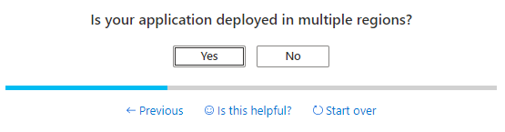
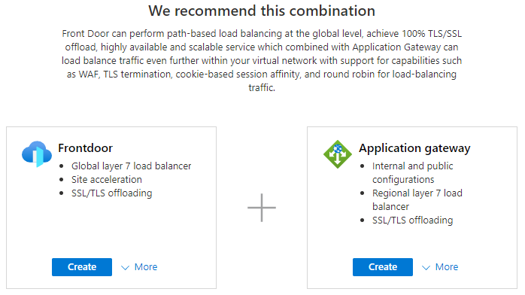
Azure Load Balancing options
OVERVIEW
Simplify experience of choosing a Load Balancing option
Service comparison in the Azure Portal
Discoverability of New Learn modules Training per Load Balancing service
Browse all Load Balancing Services in one centralized location
Microsoft Azure | @Techielass

Slide 38
DEMO
Microsoft Azure | @Techielass

Slide 39
Beyond load balancing
Microsoft Azure | @Techielass

Slide 40






Azure CDN
Media
Azure Region
App Service
Mobile
Global multi-CDN native content delivery
Multi-CDN ecosystem with top-tier providers.
Spin up CDN services without contracts
Media Services
API
Storage
files.contoso.com
Files
On Prem/External
Updates
Simplified billing
Choice and power
Cloud migration
Unlike any other CDN – Azure CDN bills only on egress and nothing else. Lower TCO than AWS or GCP.
Solve regional and global scale needs by choosing CDN provider(s) with best-of-breed capabilities
All S400/T100/Hi-Po customers need CDN. As CDN is easily switchable, it. could be the first onboarding service.
IoT
Microsoft Azure | @Techielass

Slide 41



Instant scale-out from storage with CDN
Edge Location
Azure Region
Storage
Instant value with CDN
Few clicks to setup, onboarding in < 10 min
Covers standard CDN features
Instant performance boost for content
Improved cost economics
Custom pricing for larger deals
Multiple best-of-breed networks to customize / optimize delivery
stream.contoso.com
Microsoft Global Network
Azure CDN
from Verizon
Azure CDN
from Microsoft
Azure CDN
From Akamai
Microsoft Azure | @Techielass
Microsoft Azure | @Techielass

Slide 42






Azure Managed Databases
Azure SQL Database
Azure SQL Managed Instance
Azure Database for PostgreSQL
Azure Database for MySQL
Azure Database for MariaDB
Azure Cache for Redis
Azure Cosmos DB
Managed, intelligent SQL in the cloud
Enterprise-ready, fully managed and scalable open-source databases
In-memory data store to power fast, scalable applications
Globally distributed, multi-model dataset service for any scale
Microsoft Azure | @Techielass

Slide 43
What’s Special About Azure Cache for Redis?
Fast
Loved
Fully Managed
Data is stored in-memory, not on disk
Updates, patching, and scaling handled for customers
Higher reliability with automated failover and geo distribution
Built-in Security and interoperability with Azure services
< 1ms latency
2M+ requests/second
100k+ simultaneous clients
The most loved database in Stack Overflow’s Developer Survey for four years in a row
Microsoft Azure | @Techielass

Slide 44

Simplify development with a fully managed service
Azure Cache for Redis handles patching, updates, provisioning, configuration, setup, and scaling
Utilize Azure Monitor to track dozens of parameters and metrics within the cache, infrastructure, and network
Utilize off-the-shelf .NET providers to implement popular use-cases
Backed by the community edition of open-source Redis software
Bring your own language—use any Redis client to connect to the service
.NET
Microsoft Azure | @Techielass
Microsoft Azure | @Techielass

Slide 45

Do more with your data with Azure integration
Reduce the level of database and storage requirements by implementing a caching layer
Ideal complement for Azure services like Cosmos DB, AppService, MySQL, Azure SQL, or PostgreSQL
Deploy within a virtual network to provide enhanced isolation and restrict unwanted network access
Compliant with an industry-leading number of government, industry, and regional standards
Use reserved instances to save up to 55% on Azure Cache for Redis costs
Microsoft Azure | @Techielass

Slide 46

Depend on built-in enterprise-grade capability
All tiers but basic include a redundant pair of virtual machines configured for automatic failover
Take advantage of up to 99.999% availability in the enterprise tiers.
Deploy in a zone-redundant configuration to maximize availability and uptime
Utilize active geo-replication to create global caches with local latency across regions
Run Redis on high-capacity NVMe storage to create truly massive cache sizes that meet the needs of even the largest organizations
Active-Active Geo-Replication
Primary
Replica
Region 1
Region 2
Microsoft Azure | @Techielass

Slide 47

Azure Cache for Redis is an efficient session store solution
Use case examples
eCommerce shopping carts
Storing user cookies
User login and session state
Customized pricing quotes
IoT telemetry
Example architecture
Browser
Azure API Apps instance
Browser
Azure API Apps instance
Azure Cache for Redis
Browser
Azure API Apps instance
GEICO uses Azure Cache for Redis to store insurance quotes for customers shopping online
Microsoft Azure | @Techielass

Slide 48

Publish, subscribe, and query with Azure Cache for Redis
Use case examples
Publishing news, financial data, or application updates to users
Handling chat messages
Communication between microservices
Example architecture
Group chats
Azure Web Apps
Browser
Stock quotes
Azure Cache for Redis
Azure API Apps instance
Windows App
Notification messages
Azure API Apps instance
Mobile device
Azure Redis Cache helps a pet healthcare company streamline referrals as part of a scalable, distributed microservices architecture on Azure
Microsoft Azure | @Techielass

Slide 49


Take advantage of compatibility with open-source Redis to migrate data
Use case examples
Migrating application from on-premises to the cloud
Modernizing IaaS application through new PaaS services
Example architecture
On-Prem Redis Cache
Export cache into RDB File
Create Azure Cache for Redis Instance
Import RDB file into Azure Cache for Redis
Configure application to point at new cache instance
The Nobel Prize website migrated setup to Azure, including Azure Cache for Redis, to effectively scale website performance when prizes are announced
Microsoft Azure | @Techielass

Slide 50
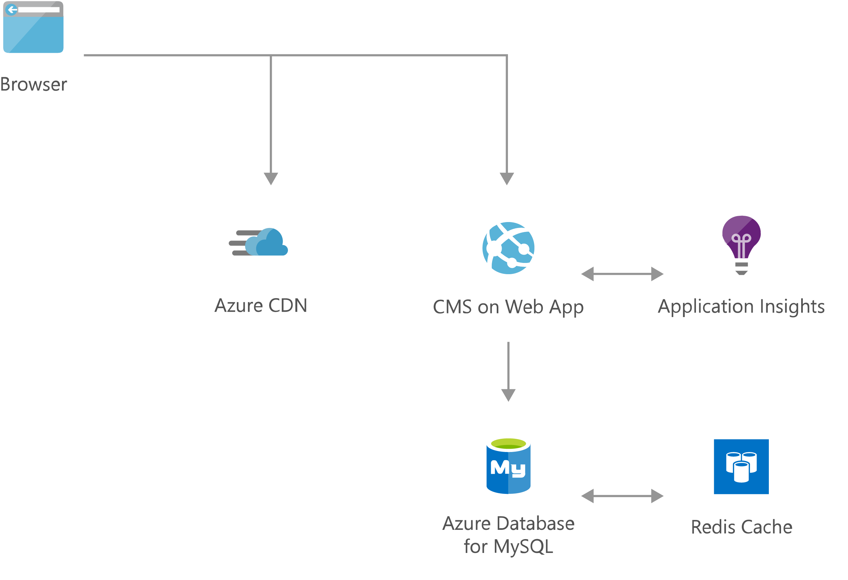
Example Architecture

Slide 51
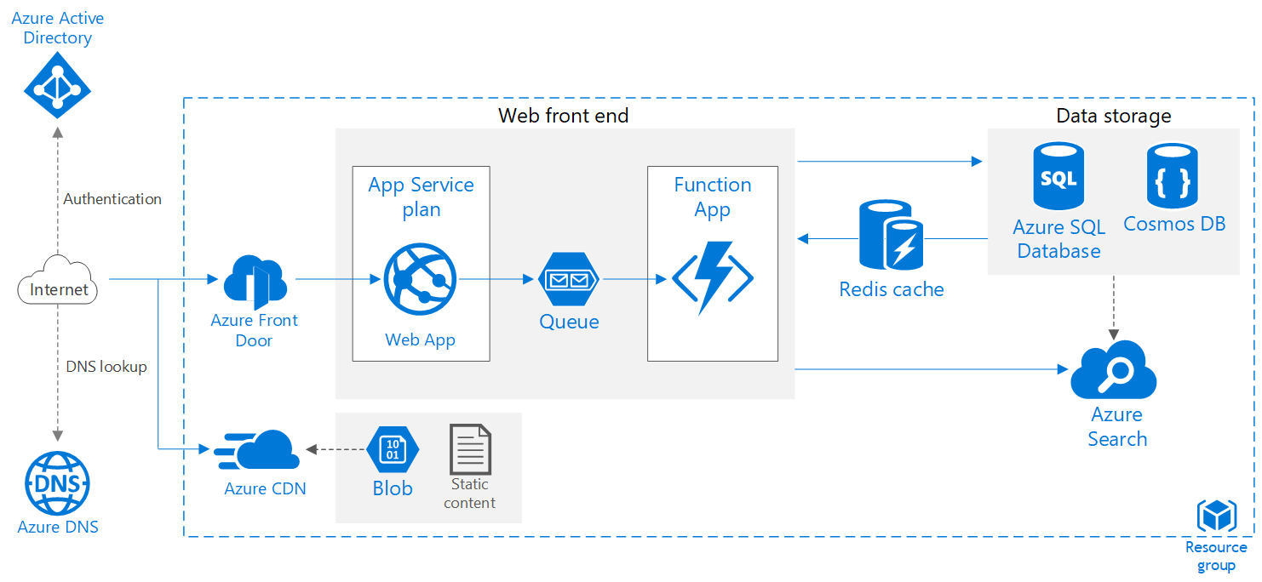
Example Architecture

Slide 52
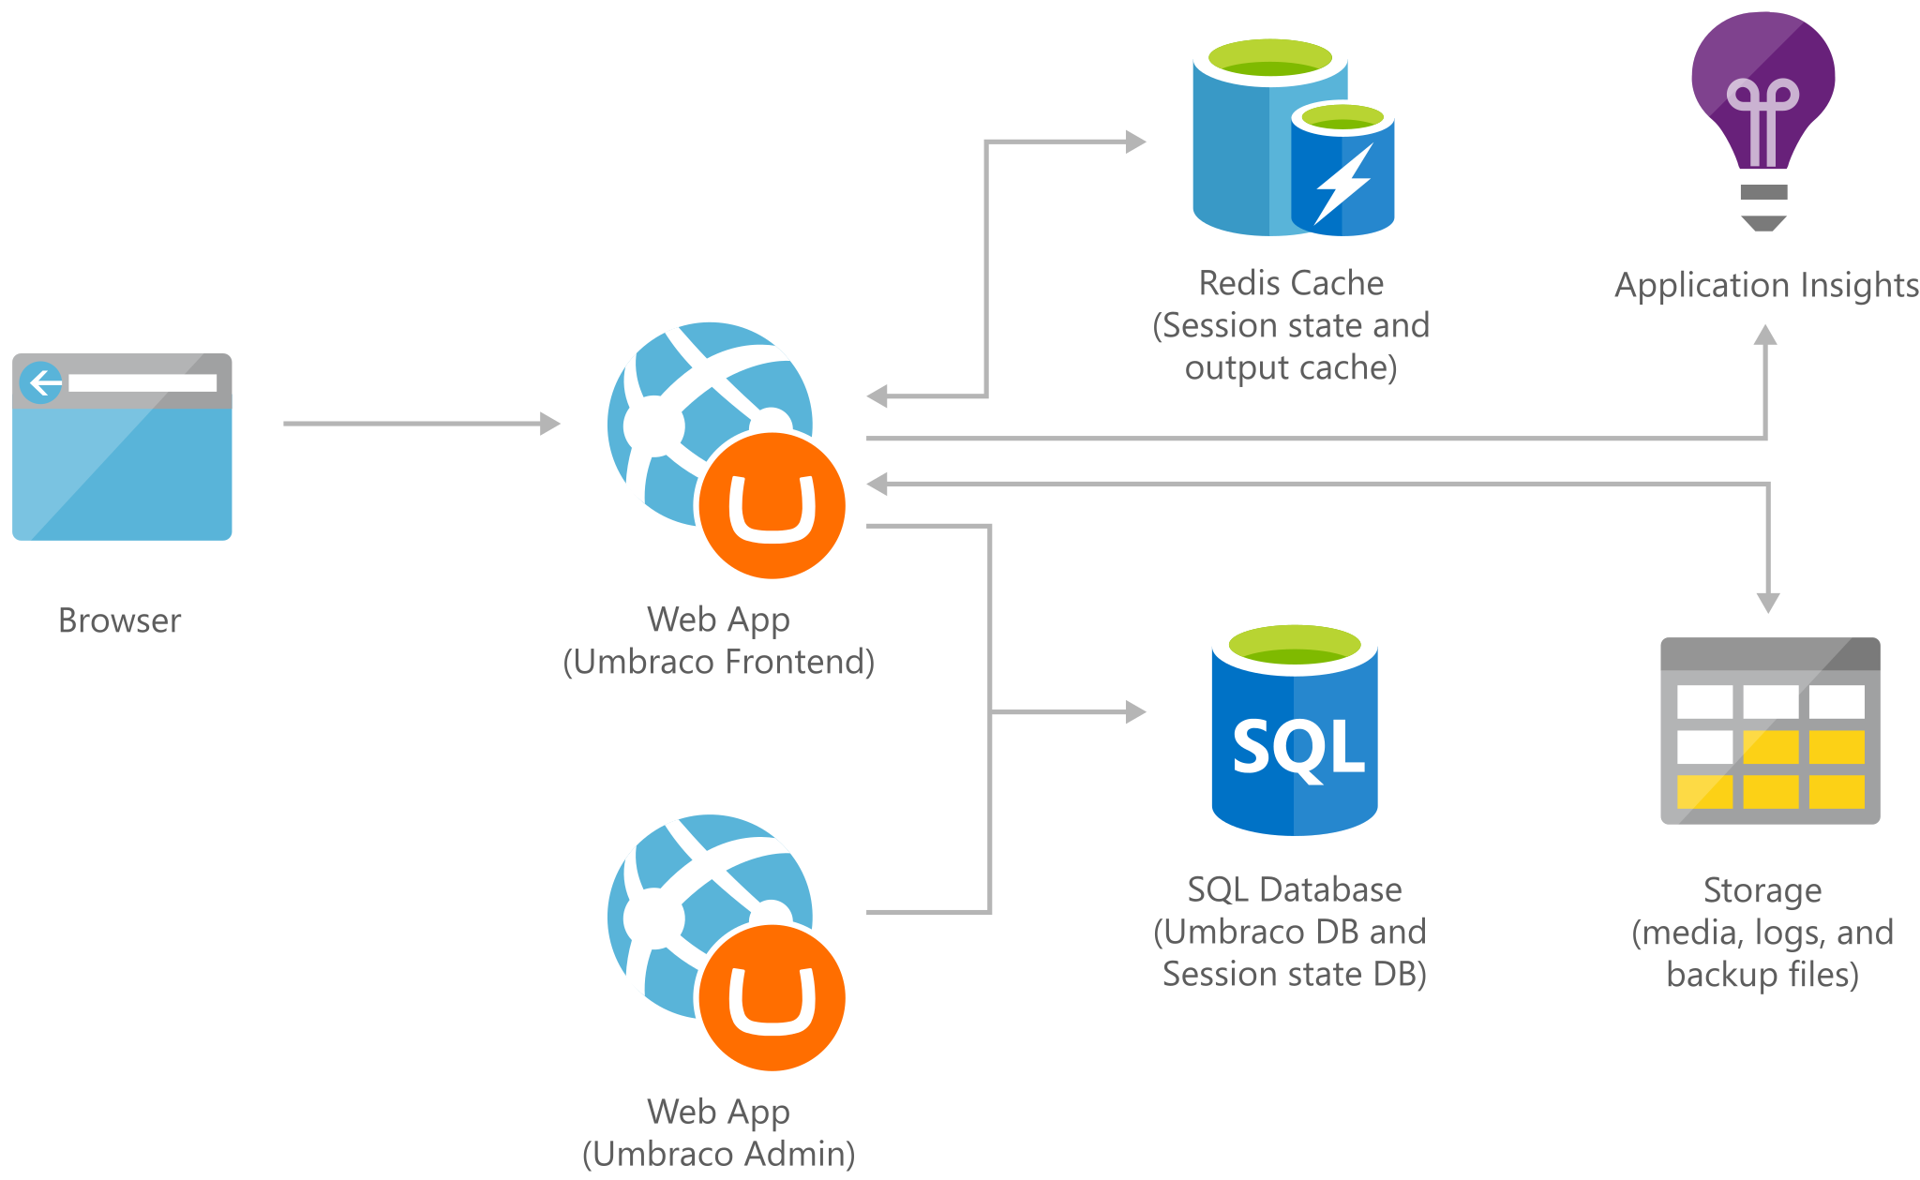
Example Architecture
https://aka.ms/networking/architecture

Slide 53

Thank you! Resources: https://aka.ms/networking/resources
Sarah Lean
Senior Cloud Advocate
@Techielass
www.techielass.com

